Slide 1
NER with Maximum Entropy Model
CISC3025 Project 3
WONG KAI YUAN (DC026157) | CHAN KA WAI (DC226165)

Slide 2
Table of contents
01
02
03
04
Introduction
Methodology
Web Demo
Training &
Testing

Slide 3
Table of contents
05
06
Future Work
Conclusion

Slide 4
01
Introduction
Quickly introduce the project and its significance in the field of NLP.

Slide 5
Purpose
Build a maximum entropy model (MEM) for identifying person names in newswire texts (Label=PERSON or Label=O), which is also called named entity recognition (NER) with high accuracy using feature sets.

Slide 6
Why NER ?
Data Analysis
Information Retrieval
Sentiment Analysis
NER is good at extracting vital information from unstructured text. Many application on Natural Language Processing.

Slide 7
02
Methodology
Explanation of the Maximum Entropy Model, the advanced features added to improve the model, and the technical implementation details using Python and NLTK.

Slide 8
Maximum Entropy
Utilizes a probabilistic framework that predicts class labels (PERSON or not) based on the statistical properties of features extracted from text.

Slide 9
Feature Engineering
Feature | What it does ? | Why ?
1) ALLCAP | Checks if the entire word is in uppercase. | Words fully in uppercase are often acronyms or headings, rarely person names, helping reduce false positives.
2) Lowercase | Checks if the entire word is lowercase. | Person names usually start with a capital letter; full lowercase often indicates common nouns or other parts of speech.
3) After Symbol | Checks the symbol after word | Names often follow certain punctuations in written text, indicating a new sentence or clause where names are more likely to appear.

Slide 10
Feature Engineering
Feature | What it does ? | Why ?
4) Number | Identifies presence of numerical characters in a word. | Numerical characters in a word typically signify that it is not a person name, useful for filtering out numerical data or mixed content.
5) Pretitle | Checks if the previous word is a common title or honorific. | Titles precede names, providing a strong contextual hint that the following word is likely a person name, thus enhancing recognition accuracy.

Slide 11
03
Training & Testing
Description of the training process, data handling, and performance metrics used to evaluate the classifier's effectiveness in identifying person names.

Slide 12
How do we do?
Data Preparation
2) Model Training
3) Model Testing
4) Model Evaluation
Using F1 Score, Accuracy, Recall, Precision.

Slide 13
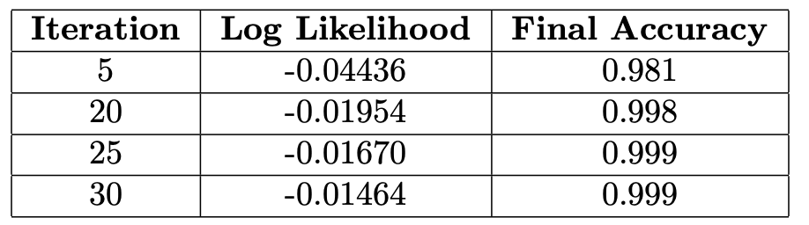
Result (Training)

Slide 14
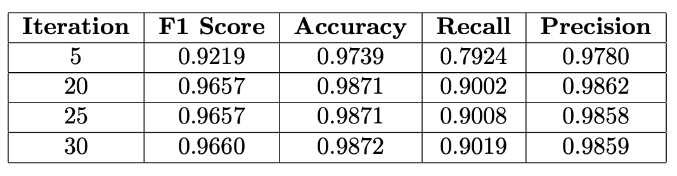
Result (Testing)
Fairly good performance to identify person’s name.

Slide 15
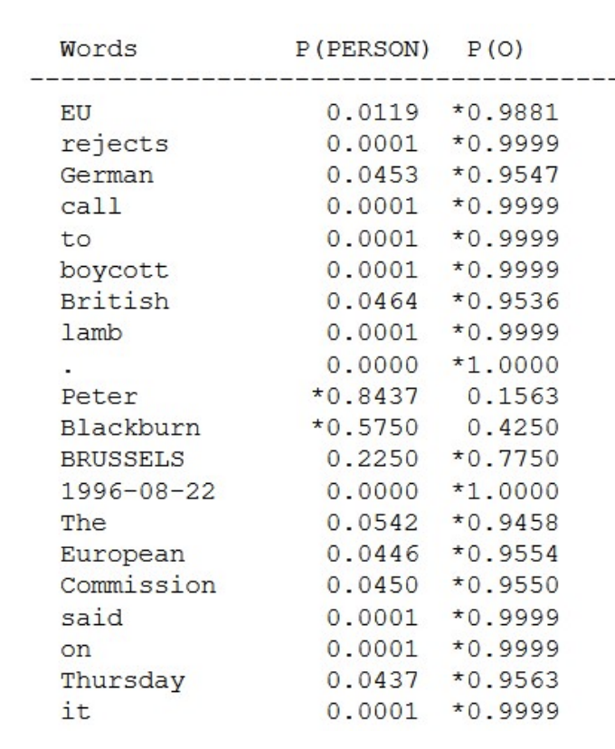
During show sample stage, model got every single one correct !

Slide 16
04
Web Demo
A quick demonstration of the web application built to showcase the model in action, illustrating how users can input text and view the NER results.

Slide 17
Overview of Web Application
Demonstrates the practical application of the enhanced NER model, allowing users to input text and see the named entity recognition results in real time.
—Purpose
Built using Flask, a lightweight Python web framework, which facilitates the creation of web applications quickly and with minimal code.
—Technology Used

Slide 18



Functionality
Users can type or paste text into a text box.
Application processes the text using the trained NER model.
The results display each word tagged accordingly as 'PERSON' or 'O' for non-person entities.

Slide 19
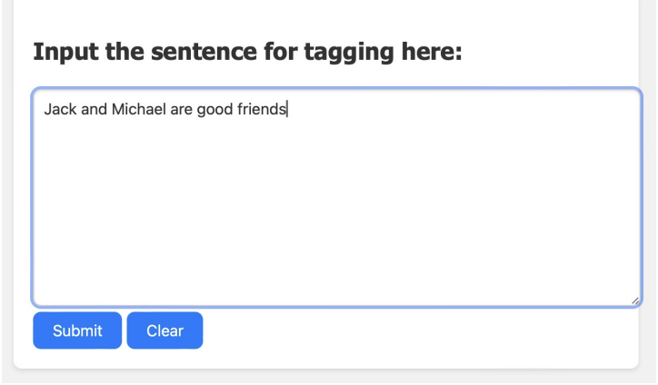
Live Demo
This is the input sentence in web application

Slide 20
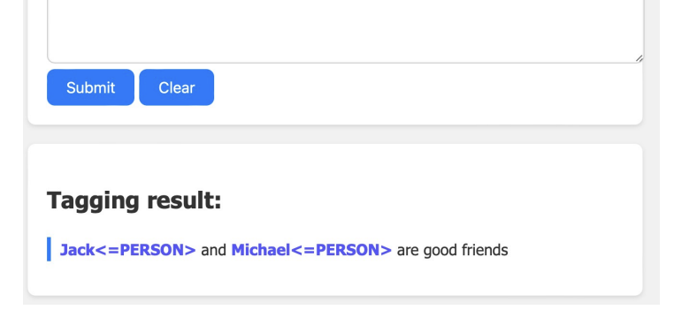
Live Demo
This is the output in web application

Slide 21
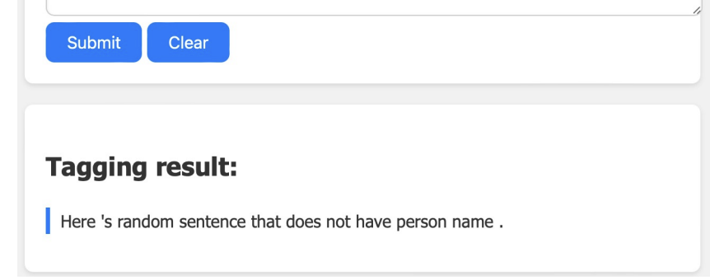
Live Demo
This is the input sentence without person name in web application

Slide 22
05
Future Work
Brief thoughts on potential future improvements.

Slide 23
Areas of Improvement
Explore the use of neural networks, such as LSTM or BERT models, to capture deeper contextual meanings and improve accuracy.
1) Integration of Deep Learning
Enhance the web application's interface to support more interactive features.
2) User Interface Enhancements
Extend the model to recognize more entity types beyond person names, such as locations, organizations, and dates.
3) Expand Entity Types

Slide 24
06
Conclusion
Summary of the project outcomes, highlighting the enhancements made to the NER system and its implications for real-world applications.

Slide 25

Project Recap
Objective Achieved: Successfully enhanced a Named Entity Recognition system using the Maximum Entropy Model to accurately identify person names in newswire texts.
Key Innovations: Implemented advanced features like ALLCAP, lowercase, after symbol, number, and pretitle, significantly improving the model's accuracy and reliability.

Slide 26
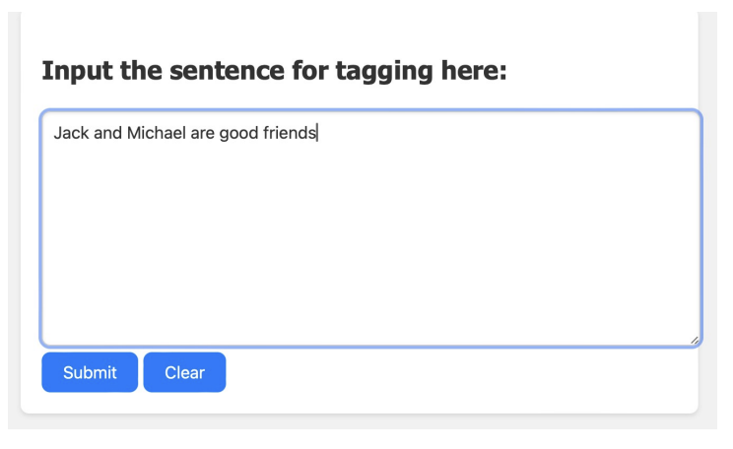
Major Accomplishments
Improved Performance: Demonstrated through rigorous training and testing, the enhanced model shows superior performance metrics compared to the baseline, particularly in precision and recall.
Practical Application: Developed a user-friendly web application that showcases the model’s real-world utility by allowing users to interactively test the NER system.

Slide 27
Thanks!
Does anyone have any questions?
Please keep this slide for attribution

